Slide 1
COMPILER SUPPORT FOR VECTORIZATION IN DATA INTENSIVE APPLICATIONS
A.Lakshmi prasanna (192210088)
K.Neha sree (192210099)
P.Brundha(192210265)
C.Gayatri(192211267)

Slide 2
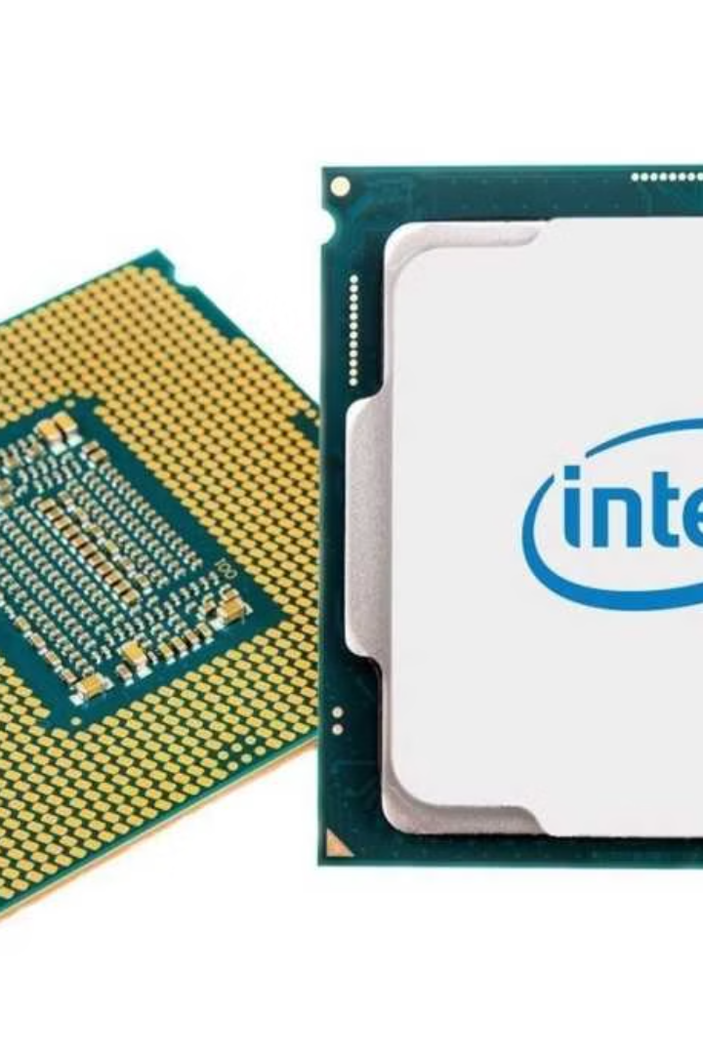
Introduction to Compiler Vectorization
Compiler vectorization is a crucial optimization technique that enables data-intensive applications to leverage the power of modern CPUs. By automatically identifying and transforming loop-based computations into efficient vector instructions, compilers can unlock significant performance gains for a wide range of applications.

Slide 3

Importance of Vectorization in Data-Intensive Applications
Improved Performance
Energy Efficiency
Competitive Advantage
Vectorization can substantially accelerate computations by executing multiple data elements simultaneously, reducing the number of CPU cycles required.
Vector instructions are more power-efficient than scalar operations, leading to reduced energy consumption and cooling requirements in data centers.
Effective compiler vectorization can provide a significant competitive edge for data-intensive applications, enabling faster data processing and analysis.

Slide 4
Challenges in Automatic Vectorization
1
Complex Control Flows
2
Memory Access Patterns
Compilers must accurately analyze and handle intricate control flow structures to enable successful vectorization.
Efficiently vectorizing memory access patterns, particularly when dealing with irregular or indirect memory references, can be challenging.
3
Aliasing Issues
4
Hardware Constraints
Compilers must precisely resolve potential data dependencies and memory aliasing to ensure the correctness of vectorized code.
Compilers must consider the specific capabilities and limitations of the target hardware architecture to generate optimized vector instructions.

Slide 5
Compiler Techniques for Effective Vectorization
Loop Transformations
Alias Analysis
Auto-Parallelization
Compilers employ advanced loop transformations, such as loop unrolling, loop interchange, and loop distribution, to expose more vectorization opportunities.
Sophisticated alias analysis techniques help compilers accurately identify and resolve memory dependencies, enabling safe and efficient vectorization.
Compilers can automatically parallelize loop iterations, leveraging vector instructions to execute multiple data elements concurrently.

Slide 6
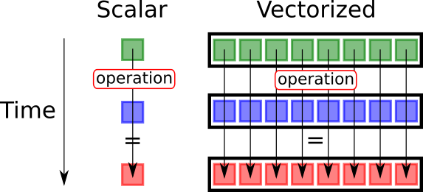
Vectorization of Loop Structures
1
Vectorizable Loops
Compilers identify loops with predictable control flow and memory access patterns that are suitable for vectorization.
2
Dependence Analysis
Compilers analyze data dependencies within loops to ensure the correctness of vectorized code and enable maximum parallelism.
3
Vector Instruction Selection
Compilers select the appropriate vector instructions based on the target hardware's capabilities and the characteristics of the loop.

Slide 7




Handling Memory Access Patterns
Stride-1 Access
Gather/Scatter Operations
Memory Alignment
Compilers prioritize vectorizing loops with contiguous memory accesses, as they are the most efficient to vectorize.
Compilers leverage gather and scatter instructions to handle irregular memory access patterns, albeit with some performance overhead.
Compilers optimize memory alignment to ensure efficient vector loads and stores, maximizing the benefits of vectorization.

Slide 8



Optimizing Vectorized Code for Performance
Hardware Awareness
Code Generation
Feedback-Driven Optimization
Compilers must consider the specific hardware features and limitations to generate the most efficient vector instructions.
Compilers employ advanced code generation techniques to produce highly optimized vector instructions, reducing overhead and improving performance.
Compilers can leverage runtime feedback and profiling data to further refine and optimize the generated vectorized code.

Slide 9
Conclusion and Future Directions
Compiler Vectorization
Vital for data-intensive applications
Ongoing Challenges
Complex control flows, memory access patterns, and hardware constraints
Future Advancements
Leveraging machine learning, domain-specific knowledge, and emerging hardware accelerators
As data-intensive workloads continue to grow, the importance of effective compiler vectorization will only increase. Ongoing research and advancements in compiler techniques, combined with the evolution of hardware architectures, will pave the way for even more efficient and widespread utilization of vector processing capabilities.

Slide 10
THANK YOU

